Slide 1


Social events for students

Slide 2



Target audience
CMSC Students
Normal people
Undergraduate students
Alumni
Graduate students

Slide 3

Project Description
1
Languages
HTML
PHP 7
JS
CSS
MariaDb

Slide 4
Project Description
Interests

Slide 5
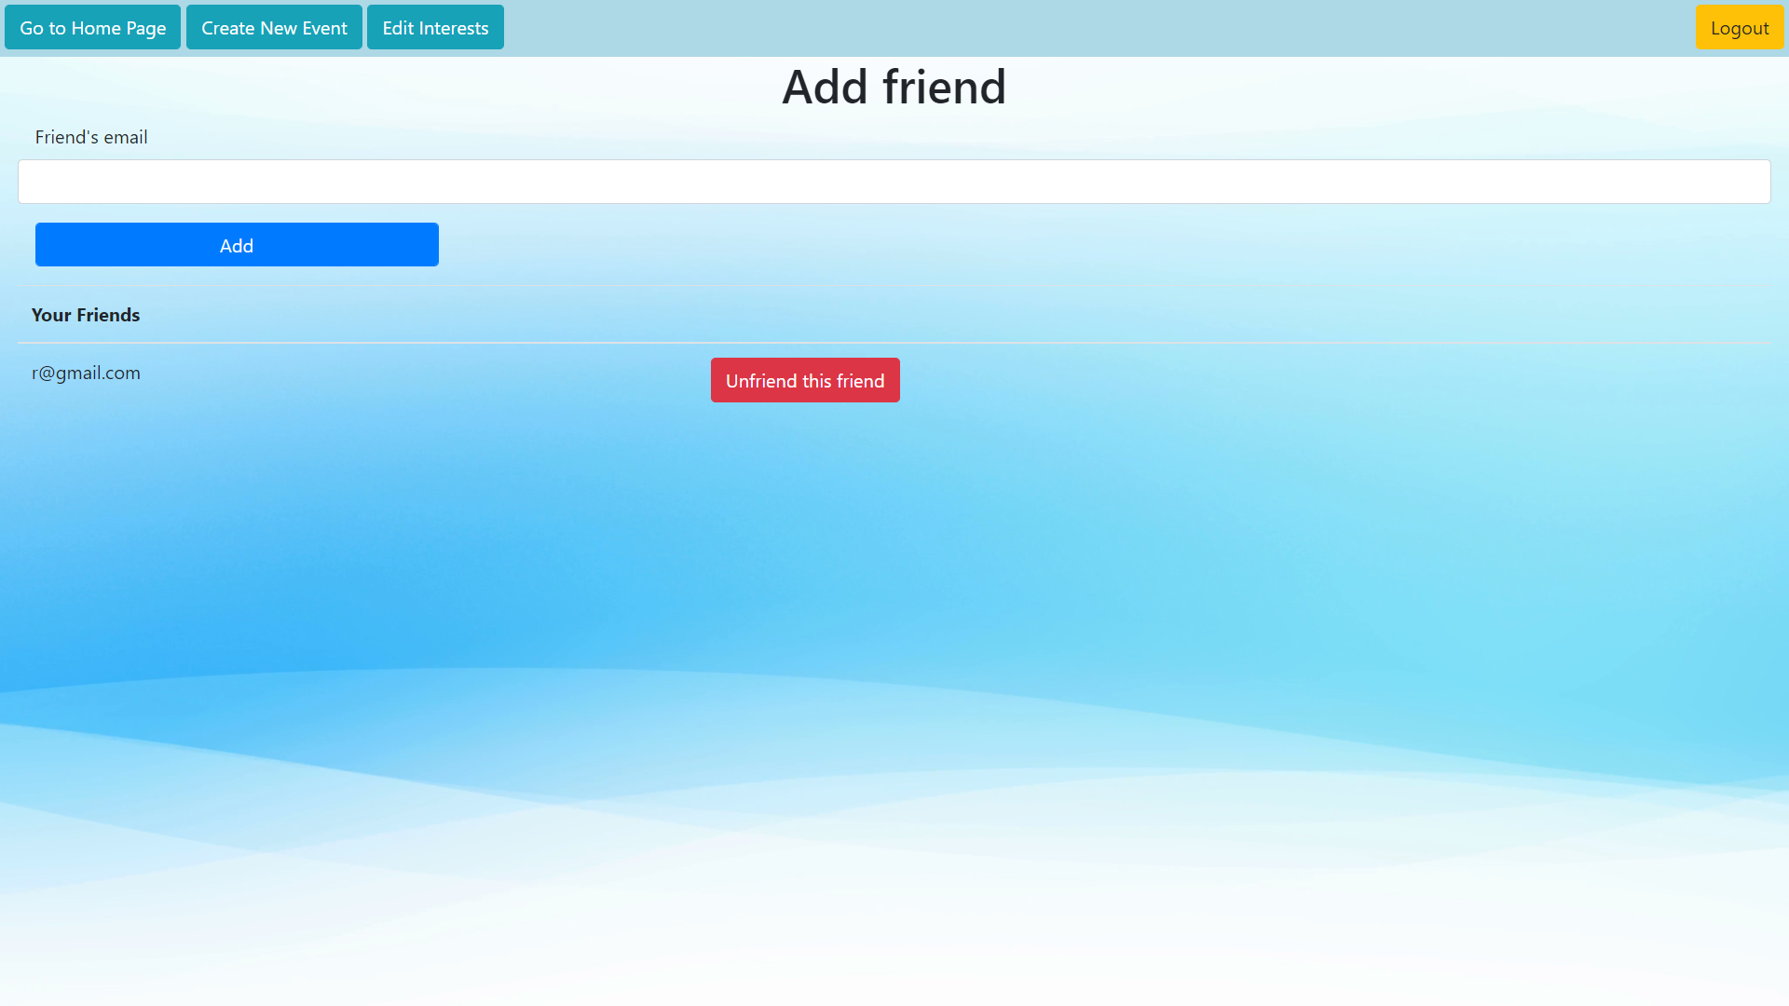
Project Description
Friends

Slide 6
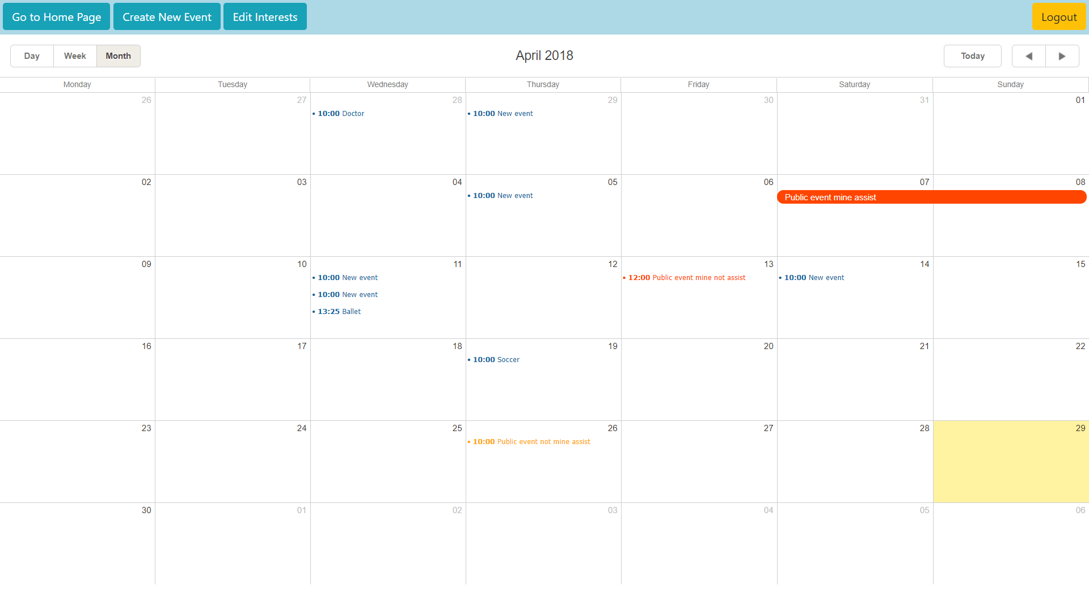
Project Description
Calendar
Insert Private events
View:
Own private events
Public events created by you
Public events you will asssist
Edit:
Own private events
Public events created by you
View Modes
Day/Week/Month

